Slide 1
CSSE 332 User-space and Kernel Thread
Thursday, April 9, 2020

Slide 2
Agenda
Review user threads and its limitation.
How kernel threads can help solve the problems?
How kernel thread works?
The implementation approaches of user/kernel threads.
Useful resource:
http://www.it.uu.se/education/course/homepage/os/vt18/module-4/implementing-threads/
http://pages.cs.wisc.edu/~remzi/OSTEP/cpu-mechanisms.pdf

Slide 3
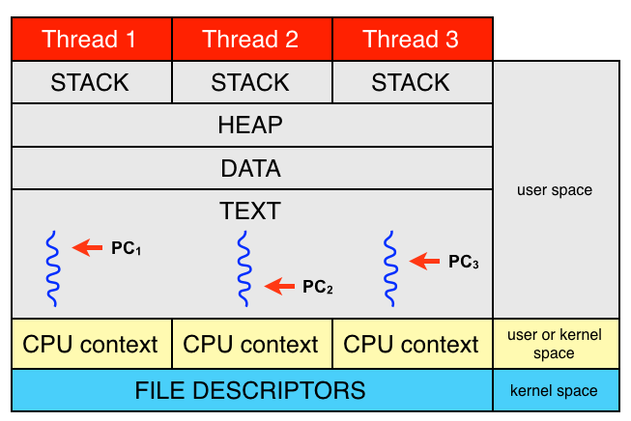
Thread overview
A subtask of a process
Comprises
A thread ID
A program counter
A register set
A stack
Shares with other threads of the same process
Code section
Data section
Other OS resources (open files, signals, etc)

Slide 4
User-space thread review
Lab1

Slide 5
User-space thread review (cont.)
Lab2

Slide 6
Limitations of user-space threads
They can't run simultaneously on multiple CPUs if my system has multiple CPUs
If one user space thread does something that causes a wait (e.g. requests something from memory, disk, the network) the OS will de-schedule all the user space threads
Without some explicit OS help, they have to manually yield – they can't be preempted

Slide 7
Many-to-One
Requires no kernel support
Cheap
Gives user programs total control
No multiprocessor parallelism
Examples:
Your user-space thread library
Solaris Green Threads
GNU Portable Threads

Slide 8
What if the scheduler scheduled individual threads rather than processes?
Multithreading
The OS knows about each thread, and can schedule them independently on different CPUs
Waiting
The OS knows about each thread, and can have one wait while others complete for the CPU
Preemption
Individuals threads can be preempted like individual processes

Slide 9
Kernel Thread
Kernel level threads are supported and managed directly by the operating system.
The kernel knows about and manages all kernel threads.
OS has to maintain the context of each kernel thread.
Provide system calls to create and manage kernel threads from user space.

Slide 10
System Call
How we request a service from the OS kernel
The API of the OS
File manipulation
Open/Close
Read/Write
Stat
Process Control
Fork/Exec
Wait
Signal
Communication
Socket
Listen/Bind
Connect
/usr/include/sys/syscall.h

Slide 11
Traps
System calls require kernel-level permissions - we can’t call the kernel is a normal way. We use a trap (very similar to an interrupt) to invoke preregistered kernel handlers.
User Mode
Kernel Mode
(1) Application makes a system call
(2) Control passes to handler
The trap table is loaded at boot by the kernel, which registers which functions to execute based on the system call number.
(3) Trap handler runs
(4) Handler returns to instruction following syscall

Slide 12
Disadvantages of kernel threads
You are stuck with whatever scheduling and rules the kernel chooses to provide
Significant overhead and increase in kernel complexity
Thread operations are hundreds of times slower compared to user-level threads

Slide 13
One-to-One
Limited number of threads available
Examples:
Windows NT/XP/2000
Linux
Solaris 9 and later

Slide 14
Hybrid approaches?
Can we get some of the cheapness and control of user-level threads with some of the power of kernel-level threads?
Yes! It’s complicated though.
Hybrid approaches tend to be used in systems that need performant massive parallelism (100s of threads).
You’ll build one of these in the Hybrid threads lab

Slide 15
Many-to-Many
Allows many user level threads to be mapped to many kernel threads
Allows the operating system to create a sufficient number of kernel threads
Examples:
Solaris prior to version 9
Windows NT/2000

